Slide 1
Employee Performance Analysis Using Excel
PRESENTED BY: R.RISHI VEL RAJ
REGISTER NO: 312204514
DEPARTMENT: COMMERCE
COLLEGE: K.C.S.KASI NADAR COLLEGE OF ARTS AND SCIENCE

Slide 2
PROJECT TITLE
Employee Performance Analysis Using Excel

Slide 3
AGENDA
1.Problem Statement
2. Project Overview
3.End Users
4.Our Solution and Proposition
5. Dataset Description
6. Modelling Approach
7. Results and Discussion
8.Conclusion

Slide 4
PROBLEM STATEMENT
Identify Top Performers
Assess the Distribution
Compare Performance
Evaluate Consistency
Report Findings

Slide 5
PROJECT OVERVIEW
Analyze performance data to identify trends and distribution. Aggregate scores for employees rated “Exceeds Expectations.” Calculate percentage distribution across performance categories. Check data for inconsistencies and anomalies. Provide recommendations for improving performance management. Prepare and present a comprehensive report with findings and insights.

Slide 6
WHO ARE THE END USERS?
HR Managers
Department Heads
Performance Review Analysts
Senior Executives
Employees

Slide 7
OUR SOLUTION AND ITS VALUE PROPOSITION
Data-Driven Insights
Enhanced Performance Management
Strategic Improvements
Consistency and Accuracy
Informed Decision-Making

Slide 8
DATASET DESCRIPTION
EMPLOYEE ID: Unique identifier for each employee in the organization.
FIRST NAME: The first name of the employee.
PAY ZONE: The pay zone or salary band to which the employee's compensation falls.
DEPARTMENT TYPE: The broader category or type of department the employee's work is associated with.
CURRENT EMPLOYEE RATING: The current rating or evaluation of the employee's overall performance.

Slide 9
MODELLING
Data set: Kaggle, Employee dataset
Feature Selection:
Data Cleaning: Missing values, Irrelevant
Pivot Table: Employee ID, First Name, Payzone, DepartmentType, Current Employee Rating.
Performance:
Report: Slicer
Chart:

Slide 10
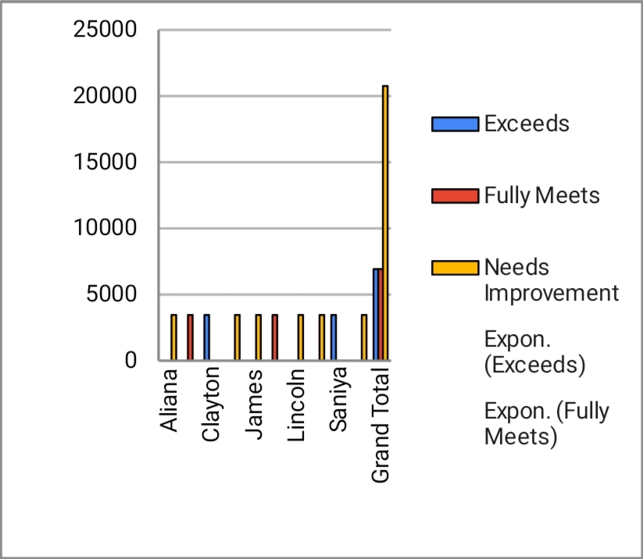
RESULTS

Slide 11
CONCLUSION
The analysis of the employee performance evaluation table reveals a significant disparity in performance distribution, with the majority of scores concentrated in the “Needs Improvement” category. Despite the substantial totals in the “Exceeds Expectations” and “Fully Meets Expectations” categories, the higher concentration in “Needs Improvement” highlights potential areas for development and intervention.
To address these findings, it is crucial to implement targeted performance management strategies and developmental programs. By focusing on areas with high “Needs Improvement” scores and leveraging insights from the top-performing employees, the organization can enhance overall employee performance, align individual contributions with organizational goals, and foster a more productive work environment.

Slide 12
REFERENCE
P.Nirmala
K.C.S.KASI NADAR COLLEGE OF ARTS AND SCIENCE

